Slide 1
SVM

Slide 2
SVM Experiments Methodology
Dataset
Select the best training data and function
1. To balance class
2. Select features
Raw data
Down sampled data
Repeat balanced data
Smote balanced data
All features
Lasso selected features
Hyperparameters
Kernel: Radial
Gamma: 1
C:1
Fit model and results interpretation
Notes:
In SVM, we also experimented with different datasets and different features. We used Raw data, downsampled and Oversampled data that using SMOTE.
We also tried training on full features and selected only features.
From those experiments, we found that by using SMOTE data, with all features, it yielded the best performance with test data.
These experiments used hyperparameters as follows

Slide 3
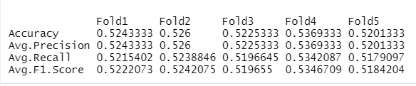
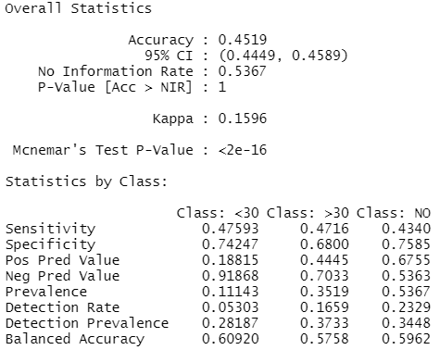
Best Result - SMOTE data
Average performance metrics on 5-fold
Performance metrics on test data
Notes:
We fit the model with best hyperparameters, and got the average performance on 5-Fold is around 52%
(add VIP from Leonard)

Slide 4
Appendix

Slide 5
Experiments
Hyperparameters
Raw data
Downsampled data
SMOTE balanced data
Full features
Selected features by Lasso
Kernel = Radial
Gamma = 1
C = 1

Slide 6

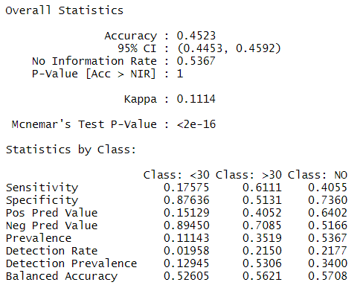
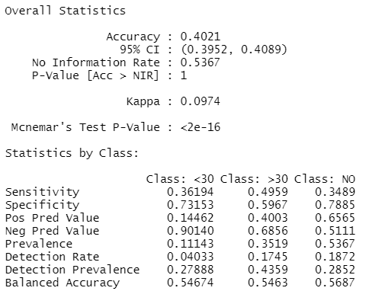
Raw data
SMOTE data
Average performance metrics on 5-fold
Average performance metrics on 5-fold
Performance metrics on test data
Performance metrics on test data

Slide 7
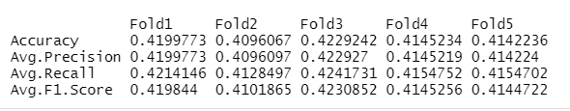
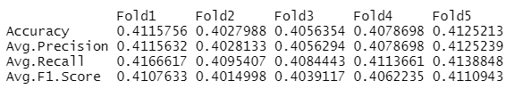
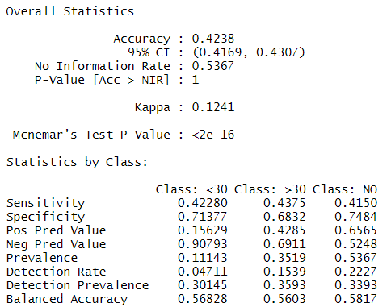

Undersampled data
Undersampled data –
Lasso selected features
Average performance metrics on 5-fold
Average performance metrics on 5-fold
Performance metrics on test data
Performance metrics on test data

